Slide 1

B.E Project
By
Anamika Sonawane
Anindita Chowdhury
Vibha Gaikwad
Project Guide :
Prof. S. B. Takmare

Slide 2
Eye Control System Based on Ameliorated Hough Transform Algorithm

Slide 3
Contents
Abstract
Introduction
Objectives
Literature Review
Problem Definition
Use-case Diagram
Class Diagram
Summary

Slide 4
Abstract
This paper proposes an eye control system employing eye gaze tracking techniques that might be helpful for those limb disabled people with healthy eyes.
Functionalities -
Moving the mouse with in the screen
Clicking to a button or an application icon

Slide 5
Introduction
More than 1 billion persons in the world have some form of disability. This corresponds to about 15% of the world's population.
census 2001 has revealed that over 21 million people in India are suffering from one or the other kind of disability. This is equivalent to 2.1% of the population.
Due to their limb handicap, such vast amount of people cannot enjoy the convenience and entertainment of the ever advancing computer technology.
So, this paper has purpose of meeting the specific needs of these limb disabled people.
Notes:
With purpose of meeting the specific needs of these limb disabled people, in this paper we design an eye control system that might be useful for those limb disabled people with healthy eyes to interact with computers.

Slide 6
Objective
Objective of our project is
to design an eye-controlled input system using hough transform.
To enable limb disabled people to use and get the experience and benefits of digital world

Slide 7
Literature Review
Eye-tracking experiments have an early history. One of the earliest eye-trackers was designed by Edmund Huey (Huey, 1908) which just consisted of a contact lens like device with a hole for the pupil.
Generally, eye tracking measures the eyeball position and determines gaze direction of a person, and the movements of the eye can be tracked using different technologies. It can be categorized into four categories: infrared-oculography (IROG), scleral search coil method (SSC), electrooculography (EOG), and video-oculography (VOG). Currently, most of the eye tracking researches for HCI are based on VOG, because the VOG technique has minimized the invasiveness to user in some degree.

Slide 8
In 2006 a group of Taiwanese engineers developed a "Powered Wheelchair controlled by Eye-Tracking system"
Almost every previous work has used head-set as an “eye tracking” device. We’re trying to replace it with conventiontional camera.

Slide 9
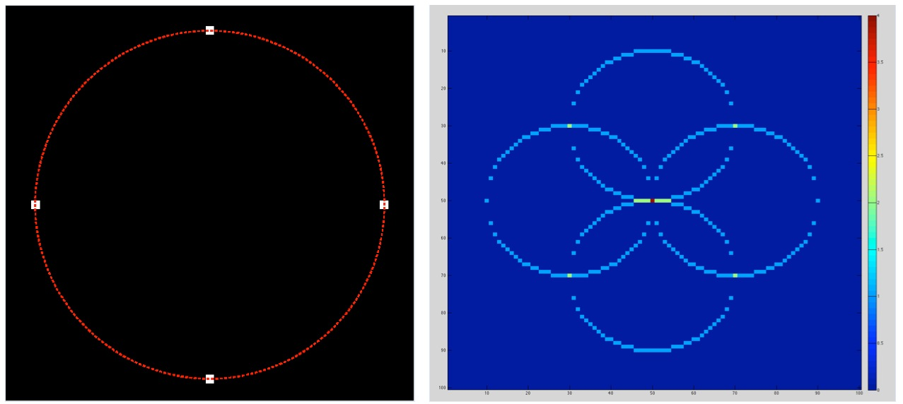
Proposed System (Base on Ameliorated Hough Transform Algorithm)
The Hough transform is a feature extraction technique used in image analysis, computer vision, and digital image processing.
Circle Hough Transform

Slide 10
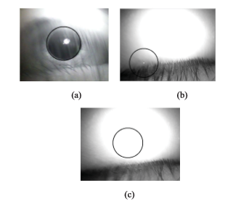
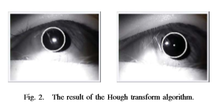

Slide 11
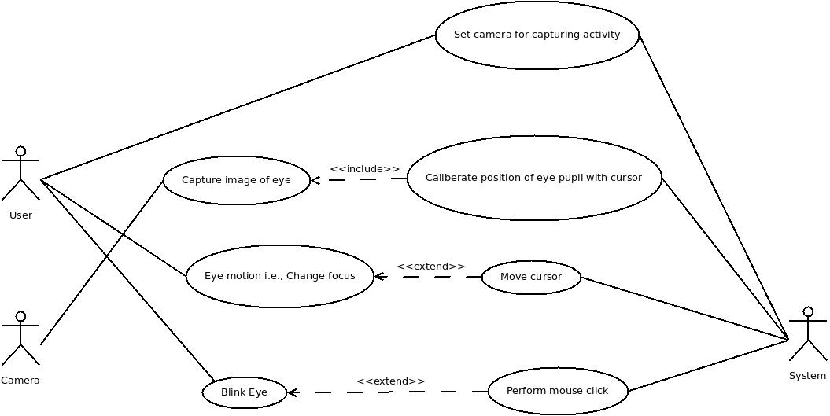
Use- case Diagram

Slide 12
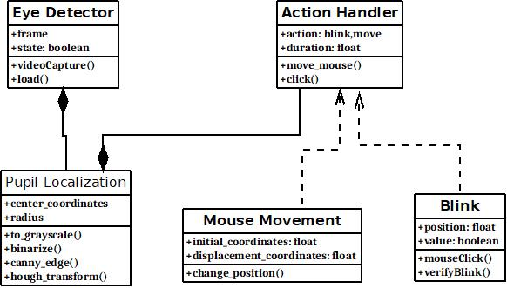
Class Diagram

Slide 13

Thank You

